Slide 1
卷积神经网络 II

Slide 2
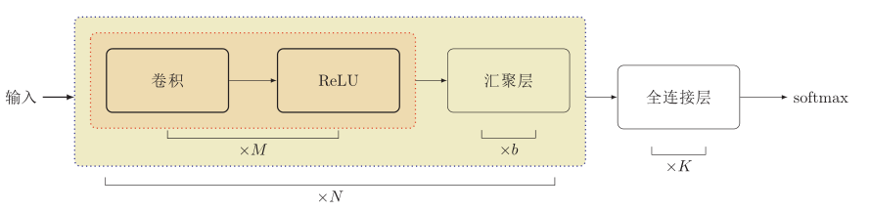
卷积网络结构
卷积网络是由卷积层、汇聚层、全连接层交叉堆叠而成。
趋向于小卷积、大深度
趋向于全卷积
典型结构
一个卷积块为连续M 个卷积层和b个汇聚层（M通常设置为2 ∼ 5，b为0或1）。一个卷积网络中可以堆叠N 个连续的卷积块，然后在接着K 个全连接层（N 的取值区间比较大，比如1 ∼ 100或者更大；K一般为0 ∼ 2）。

Slide 3
其它卷积种类

Slide 4
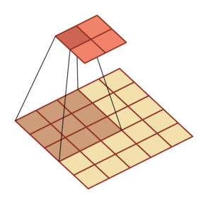
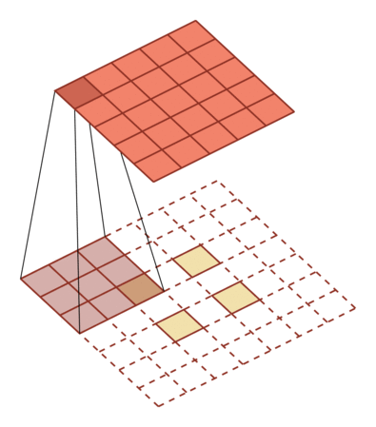
转置卷积/微步卷积
低维特征映射到高维特征

Slide 5
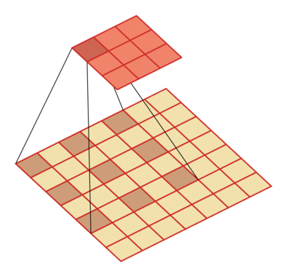
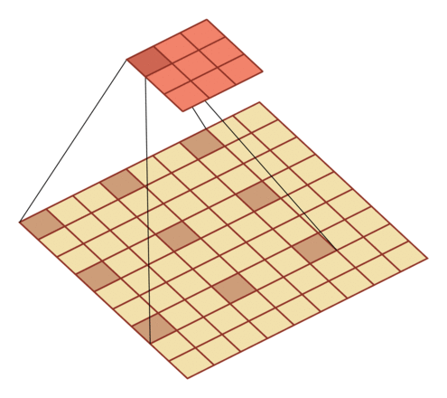
空洞卷积
如何增加输出单元的感受野
增加卷积核的大小
增加层数来实现
在卷积之前进行汇聚操作
空洞卷积
通过给卷积核插入“空洞”来变相地增加其大小。

Slide 6
典型的卷积网络

Slide 7
卷积神经网络
CNN模型结构变迁
针对移动端的轻量型网络
VGGNet
(2014)
ResNet
(2015)
DenseNet
(2016)
NAS
(2018)
LeNet
(1998)
AlexNet
(2012)
NIN(2013)
GoogLeNet
(2014)
SqueezeNet
(2016.02)
MobileNet V3
(2016.04)
ShuffleNet
(2016.06)
Xception
(2016.10)

Slide 8
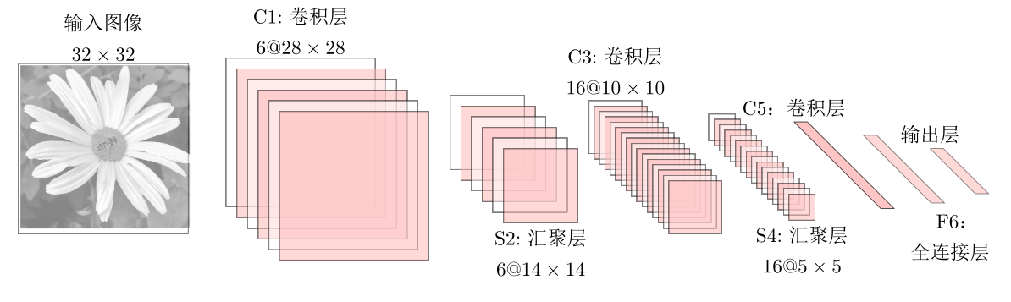
LeNet-5
LeNet-5 是一个非常成功的神经网络模型。
基于 LeNet-5 的手写数字识别系统在 90 年代被美国很多银行使用，用来识别支票上面的手写数字。
LeNet-5 共有 7 层。
需要多少个卷积核？
Notes:
输入层：输入图像大小为 32 × 32 = 1024。
C1 层：这一层是卷积层。滤波器的大小是 5×5 = 25，共有 6 个滤
波器。得到 6 组大小为 28 × 28 = 784 的特征映射。因此，C1 层的
神经元个数为 6 × 784 = 4,704。可训练参数个数为
6 × 25 + 6 = 156。连接数为 156 × 784 = 122,304（包括偏置在内，
下同）。
S2 层：这一层为子采样层。由 C1 层每组特征映射中的 2 × 2 邻域
点次采样为 1 个点，也就是 4 个数的平均。

Slide 9
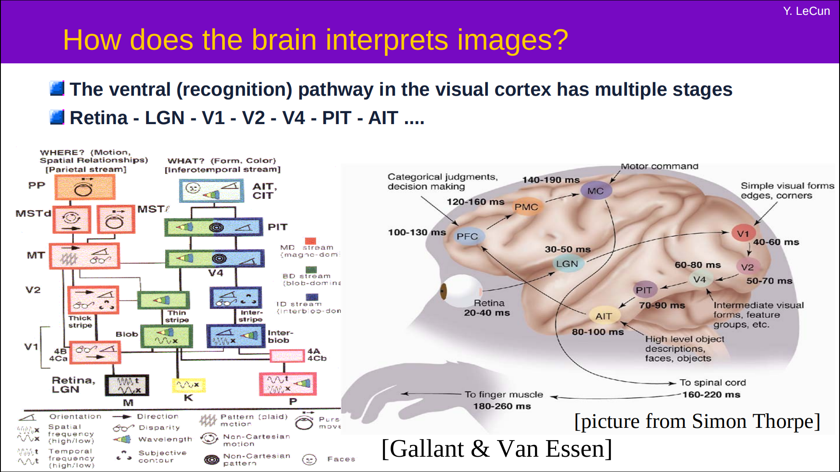
LeNet-5 卷积网络结构

Slide 10
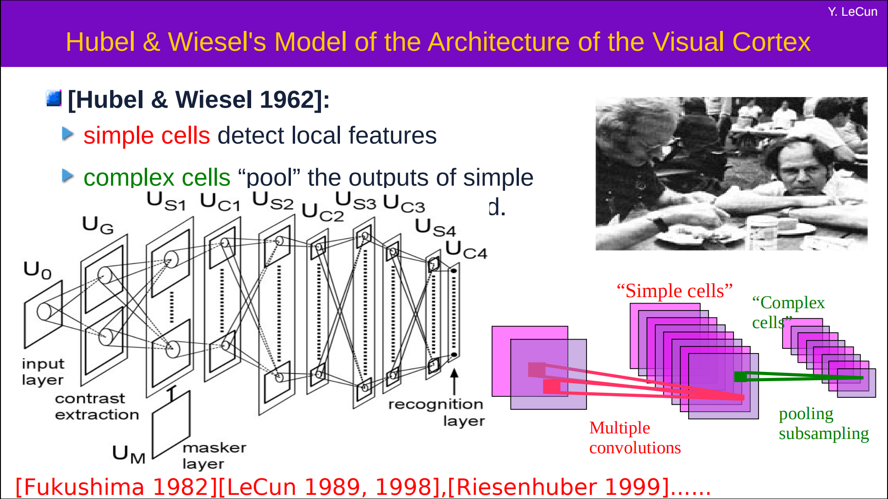
LeNet-5 卷积网络结构

Slide 11
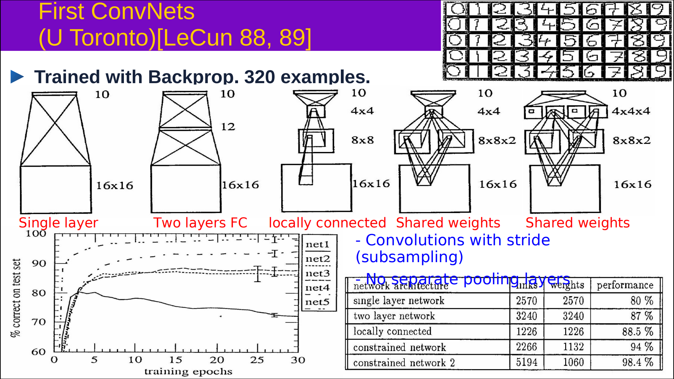
LeNet-5 卷积网络结构

Slide 12
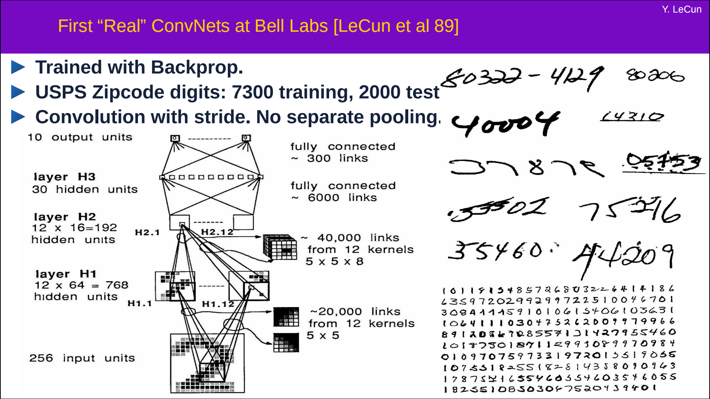
LeNet-5 卷积网络结构

Slide 13
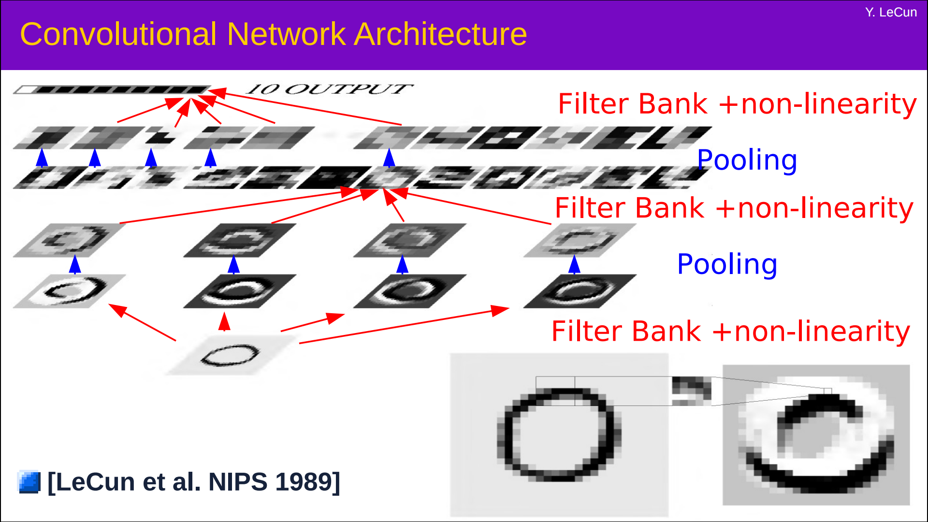
LeNet-5 卷积网络结构

Slide 14
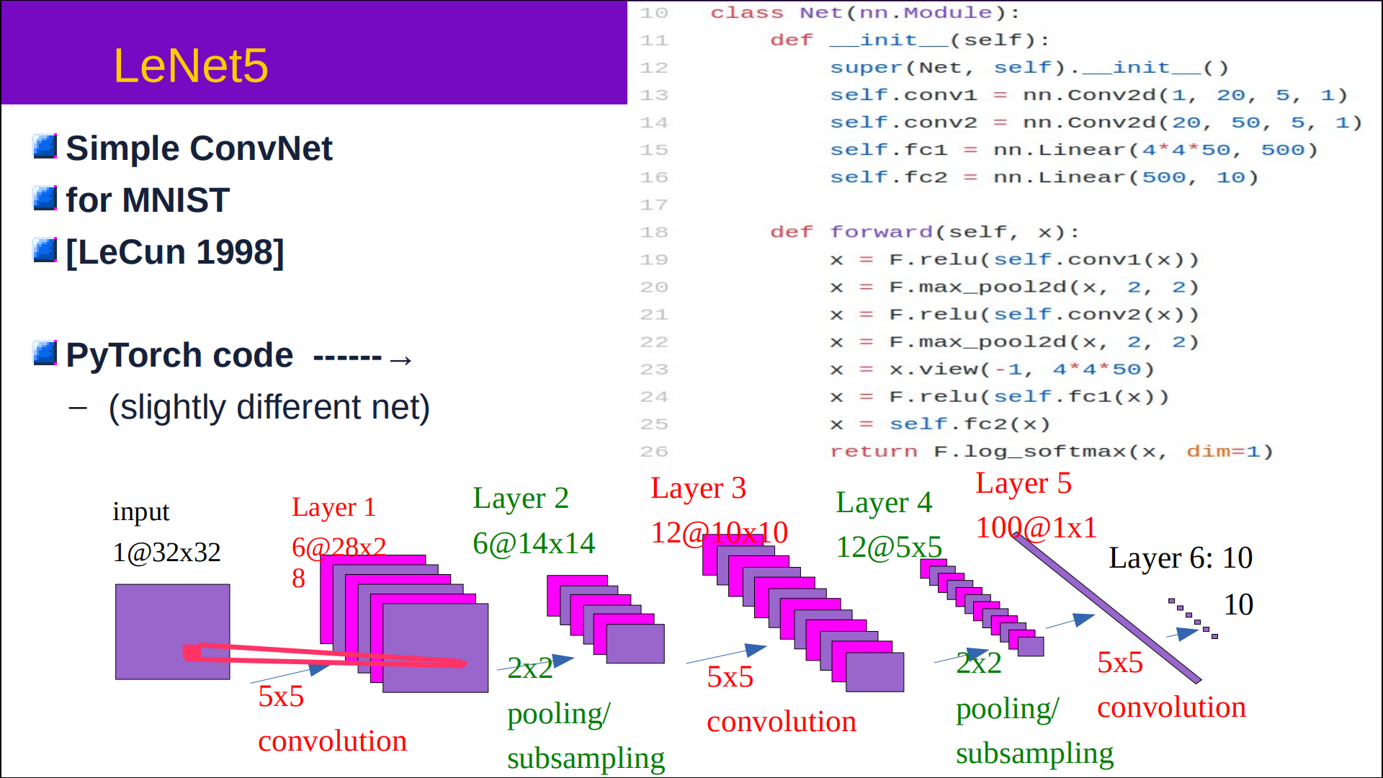
LeNet-5 卷积网络结构

Slide 15
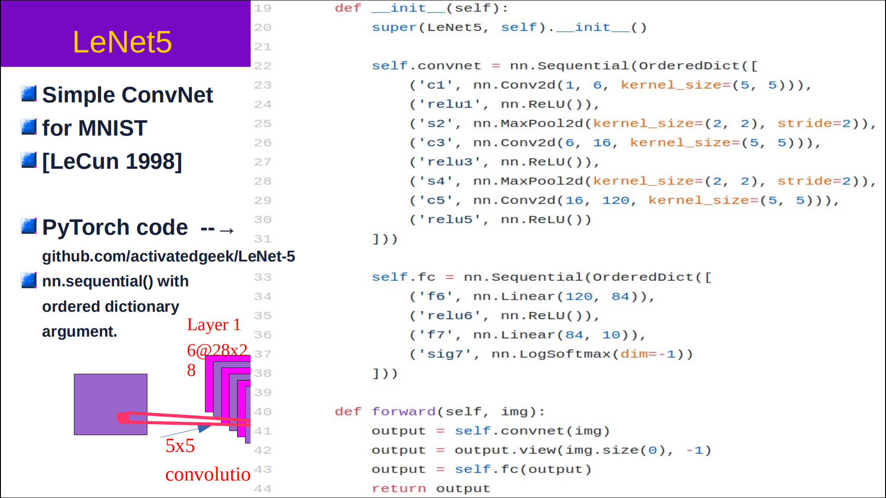
LeNet-5 卷积网络结构

Slide 16
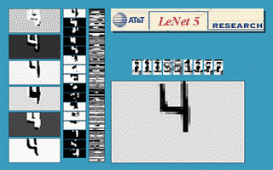
卷积网络结构
https://atcold.github.io/pytorch-Deep-Learning/zh/week03/03-2/

Slide 17
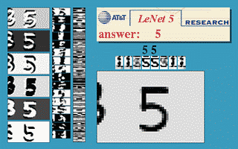
LeNet-5 卷积网络结构
https://atcold.github.io/pytorch-Deep-Learning/zh/week03/03-2/

Slide 18
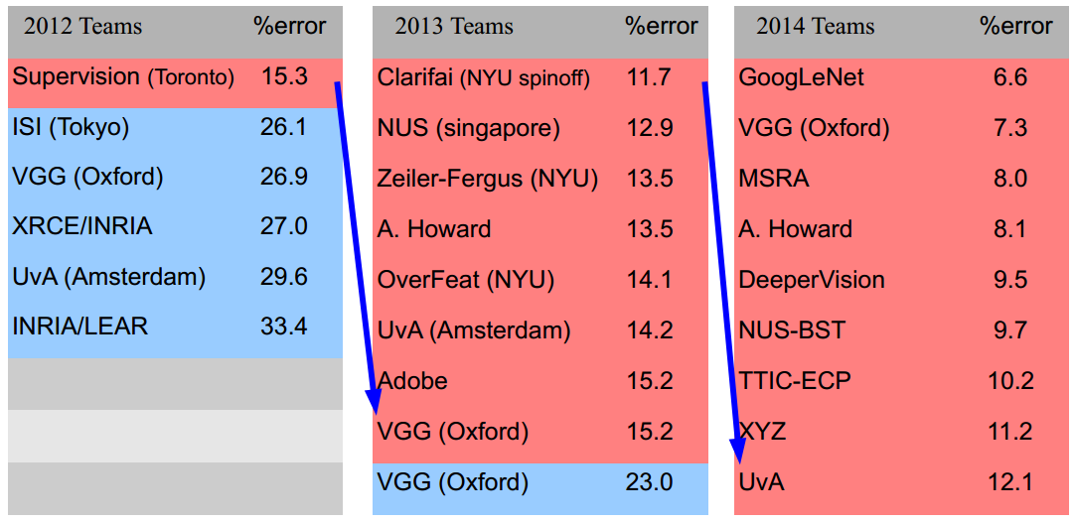
Large Scale Visual Recognition Challenge

Slide 19
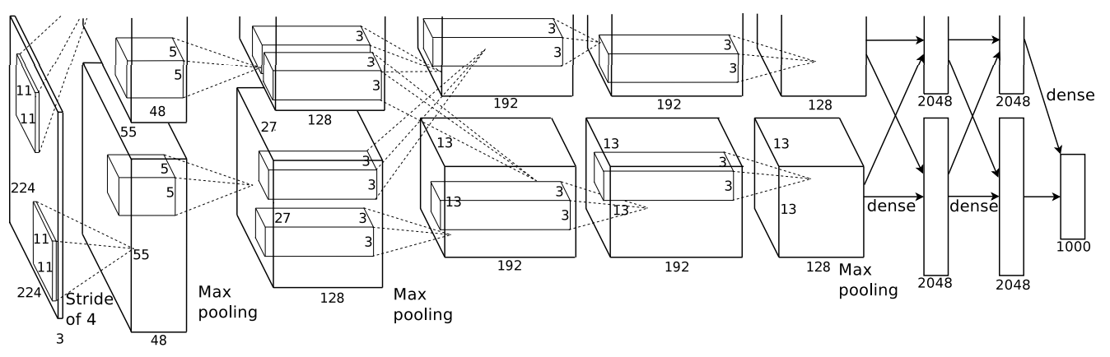
AlexNet
2012 ILSVRC winner
（top 5 error of 16% compared to runner-up with 26% error）
第一个现代深度卷积网络模型，首次使用了很多现代深度卷积网络的一些技术方法，
比如使用GPU进行并行训练，采用了ReLU作为非线性激活函数，使用Dropout防止过拟合，使用数据增强
5个卷积层、3个汇聚层和3个全连接层

Slide 20
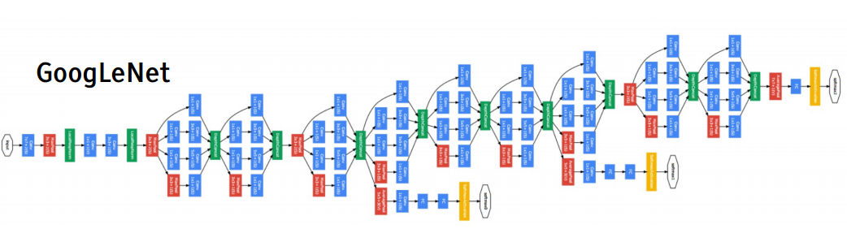
Inception网络
2014 ILSVRC winner （22层）
参数：GoogLeNet：4M VS AlexNet：60M
错误率：6.7%
Inception网络是由有多个inception模块和少量的汇聚层堆叠而成。

Slide 21
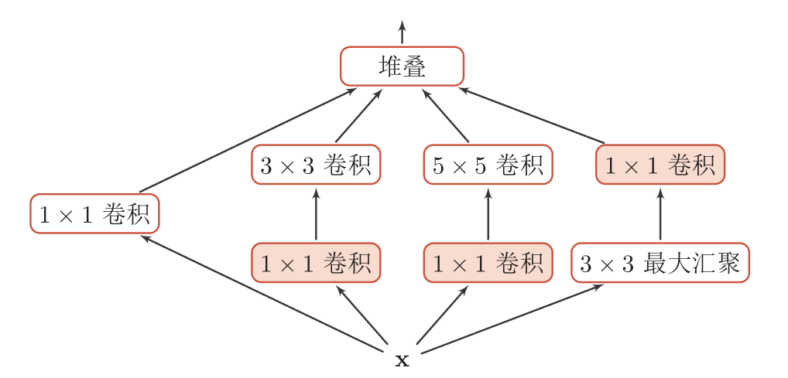
Inception模块 v1
在Inception网络中，一个卷积层包含多个不同大小的卷积操作，称为Inception模块。
Inception模块同时使用1 × 1、3 × 3、5 × 5等不同大小的卷积核，并将得到的特征映射在深度上拼接（堆叠）起来作为输出特征映射。
卷积和最大汇聚都是等宽的。

Slide 22
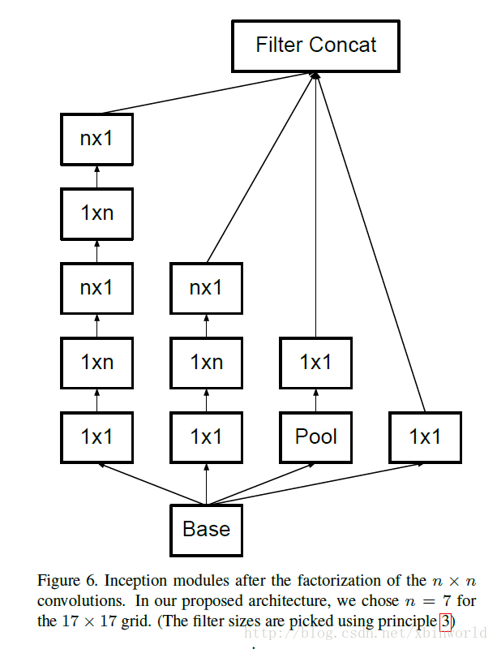
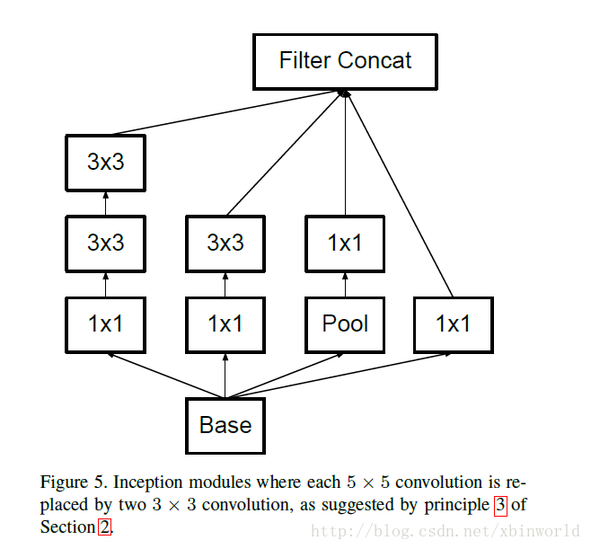
Inception模块 v3
用多层的小卷积核来替换大的卷积核，以减少计算量和参数量。
使用两层3x3的卷积来替换v1中的5x5的卷积
使用连续的nx1和1xn来替换nxn的卷积。

Slide 23
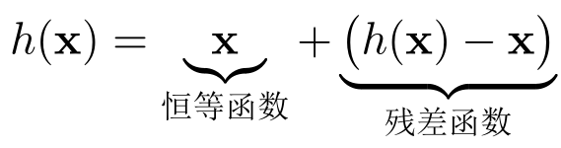
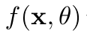
残差网络
残差网络（Residual Network，ResNet）是通过给非线性的卷积层增加直连边的方式来提高信息的传播效率。
假设在一个深度网络中，我们期望一个非线性单元（可以为一层或多层的卷积层）f(x,θ)去逼近一个目标函数为h(x)。
将目标函数拆分成两部分：恒等函数和残差函数

Slide 24
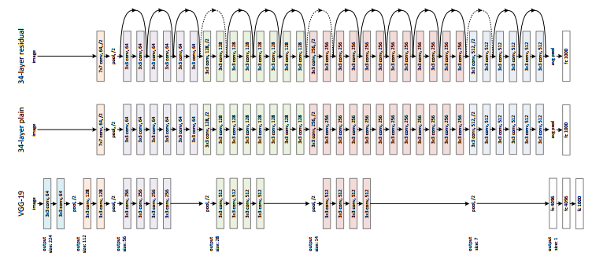
ResNet
2015 ILSVRC winner （152层）
错误率：3.57%

Slide 25
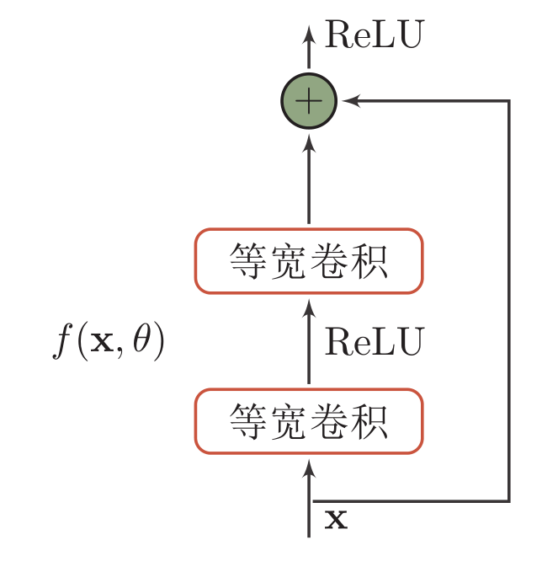
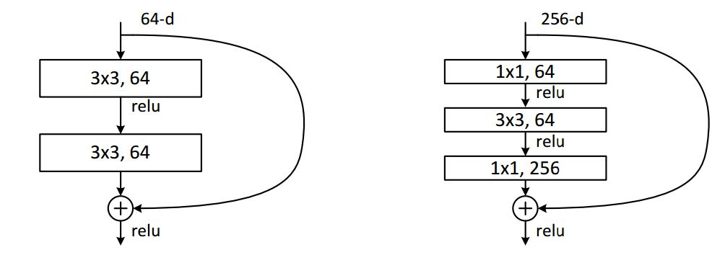
残差单元

Slide 26
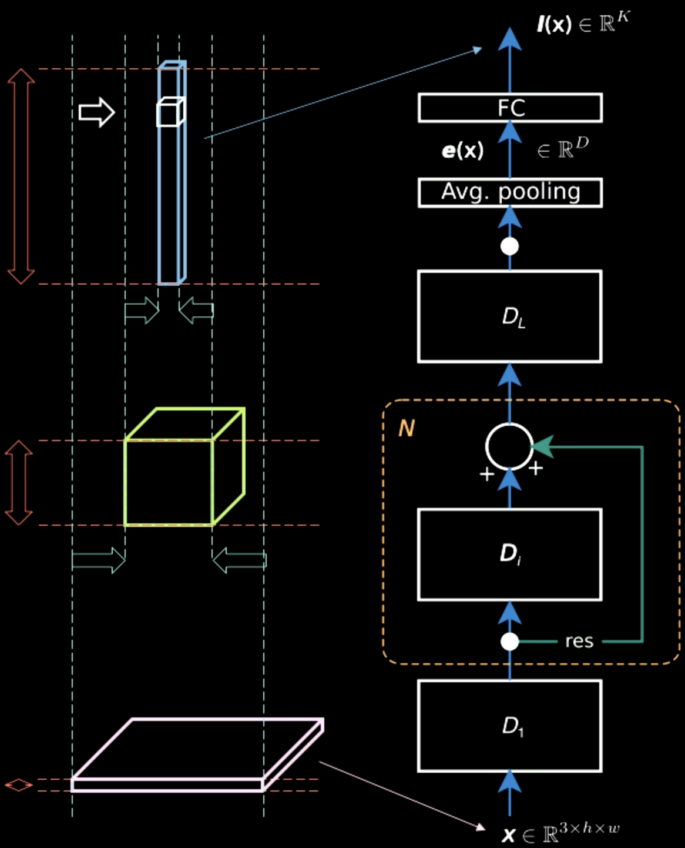
残差单元

Slide 27
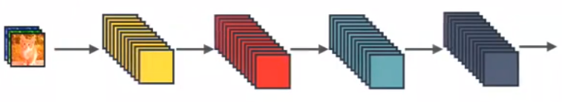
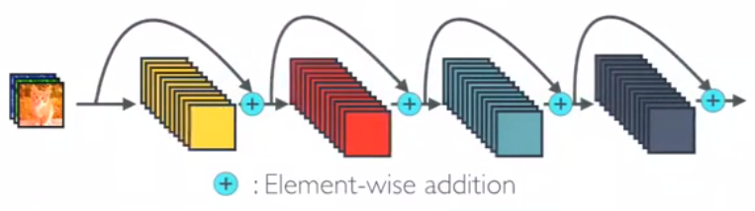
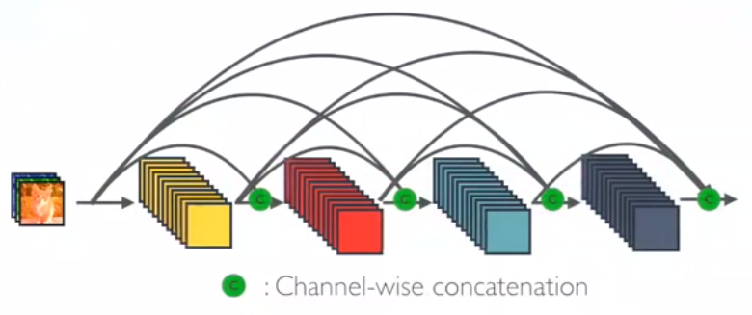
DenseNet
Standard CNN
ResNet
DenseNet

Slide 28
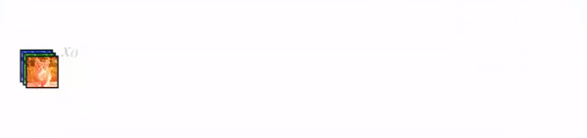
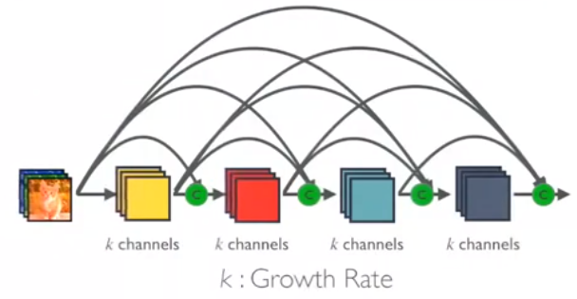
DenseNet

Slide 29
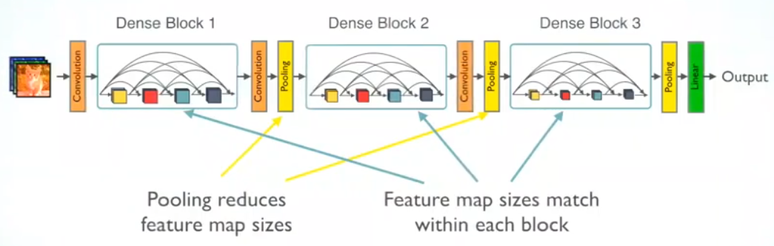
DenseNet

Slide 30
CNN可视化

Slide 31

CNN 可视化：滤波器
AlexNet中的滤波器（96 filters [11x11x3]）
Notes:
Example filters learned by Krizhevsky et al. Each of the 96 filters shown here is of size [11x11x3], and each one is shared by the 55*55 neurons in one depth slice. Notice that the parameter sharing assumption is relatively reasonable: If detecting a horizontal edge is important at some location in the image, it should intuitively be useful at some other location as well due to the translationally-invariant structure of images. There is therefore no need to relearn to detect a horizontal edge at every one of the 55*55 distinct locations in the Conv layer output volume.

Slide 32

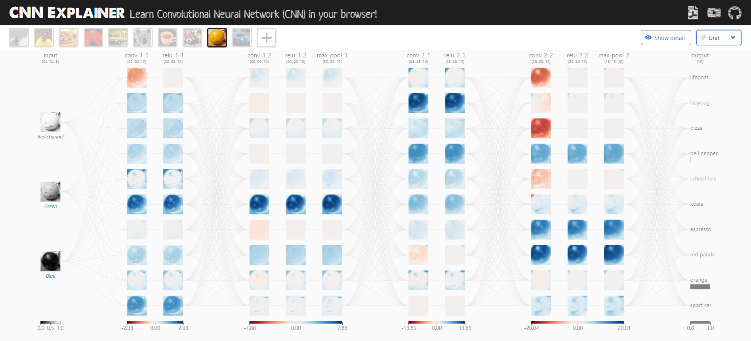
CNN 可视化：CNN Explainer 解释器
CNN解释器：https://poloclub.github.io/cnn-explainer/
GitHub：https://github.com/poloclub/cnn-explainer
论文：https://arxiv.org/abs/2004.15004
佐治亚理工 Zijie Wang
Notes:
Example filters learned by Krizhevsky et al. Each of the 96 filters shown here is of size [11x11x3], and each one is shared by the 55*55 neurons in one depth slice. Notice that the parameter sharing assumption is relatively reasonable: If detecting a horizontal edge is important at some location in the image, it should intuitively be useful at some other location as well due to the translationally-invariant structure of images. There is therefore no need to relearn to detect a horizontal edge at every one of the 55*55 distinct locations in the Conv layer output volume.

Slide 33
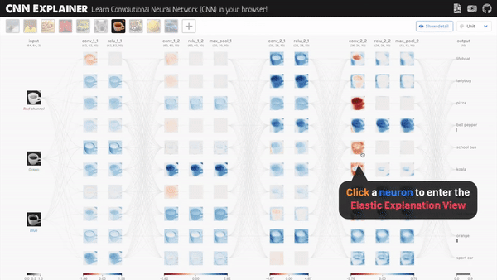
CNN 可视化：CNN Explainer 解释器
单击神经元，进入弹性解释视图，就可以看到卷积核滑动的过程的动画模拟：
Notes:
Example filters learned by Krizhevsky et al. Each of the 96 filters shown here is of size [11x11x3], and each one is shared by the 55*55 neurons in one depth slice. Notice that the parameter sharing assumption is relatively reasonable: If detecting a horizontal edge is important at some location in the image, it should intuitively be useful at some other location as well due to the translationally-invariant structure of images. There is therefore no need to relearn to detect a horizontal edge at every one of the 55*55 distinct locations in the Conv layer output volume.

Slide 34
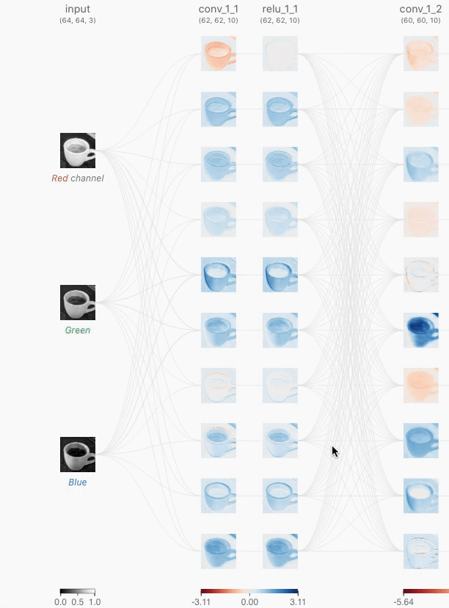
CNN 可视化：CNN Explainer 解释器
单击神经元，进入弹性解释视图，就可以看到卷积核滑动的过程的动画模拟：
Notes:
Example filters learned by Krizhevsky et al. Each of the 96 filters shown here is of size [11x11x3], and each one is shared by the 55*55 neurons in one depth slice. Notice that the parameter sharing assumption is relatively reasonable: If detecting a horizontal edge is important at some location in the image, it should intuitively be useful at some other location as well due to the translationally-invariant structure of images. There is therefore no need to relearn to detect a horizontal edge at every one of the 55*55 distinct locations in the Conv layer output volume.

Slide 35
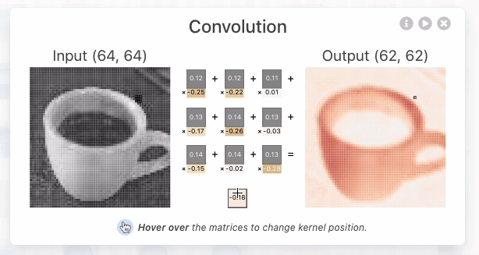
CNN 可视化：CNN Explainer 解释器
单击神经元，进入弹性解释视图，就可以看到卷积核滑动的过程的动画模拟：
Notes:
Example filters learned by Krizhevsky et al. Each of the 96 filters shown here is of size [11x11x3], and each one is shared by the 55*55 neurons in one depth slice. Notice that the parameter sharing assumption is relatively reasonable: If detecting a horizontal edge is important at some location in the image, it should intuitively be useful at some other location as well due to the translationally-invariant structure of images. There is therefore no need to relearn to detect a horizontal edge at every one of the 55*55 distinct locations in the Conv layer output volume.

Slide 36
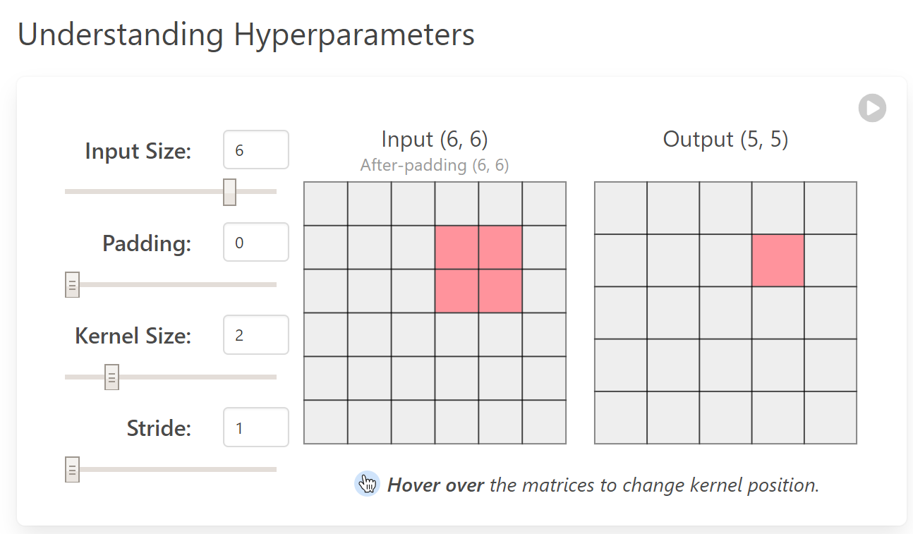
CNN 可视化：CNN Explainer 解释器
理解超参：
Notes:
Example filters learned by Krizhevsky et al. Each of the 96 filters shown here is of size [11x11x3], and each one is shared by the 55*55 neurons in one depth slice. Notice that the parameter sharing assumption is relatively reasonable: If detecting a horizontal edge is important at some location in the image, it should intuitively be useful at some other location as well due to the translationally-invariant structure of images. There is therefore no need to relearn to detect a horizontal edge at every one of the 55*55 distinct locations in the Conv layer output volume.

Slide 37
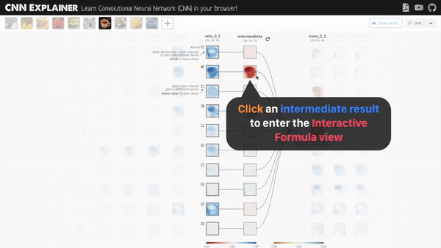
CNN 可视化：CNN Explainer 解释器
点击一个正在卷积的过程图，就可以看到更具体的过程：
Notes:
Example filters learned by Krizhevsky et al. Each of the 96 filters shown here is of size [11x11x3], and each one is shared by the 55*55 neurons in one depth slice. Notice that the parameter sharing assumption is relatively reasonable: If detecting a horizontal edge is important at some location in the image, it should intuitively be useful at some other location as well due to the translationally-invariant structure of images. There is therefore no need to relearn to detect a horizontal edge at every one of the 55*55 distinct locations in the Conv layer output volume.

Slide 38
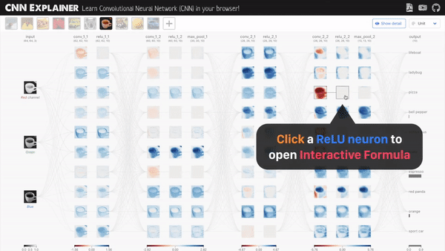
CNN 可视化：CNN Explainer 解释器
点击一个ReLU层的神经元，可以看具体过程，ReLU函数是这样工作的：
Notes:
Example filters learned by Krizhevsky et al. Each of the 96 filters shown here is of size [11x11x3], and each one is shared by the 55*55 neurons in one depth slice. Notice that the parameter sharing assumption is relatively reasonable: If detecting a horizontal edge is important at some location in the image, it should intuitively be useful at some other location as well due to the translationally-invariant structure of images. There is therefore no need to relearn to detect a horizontal edge at every one of the 55*55 distinct locations in the Conv layer output volume.

Slide 39
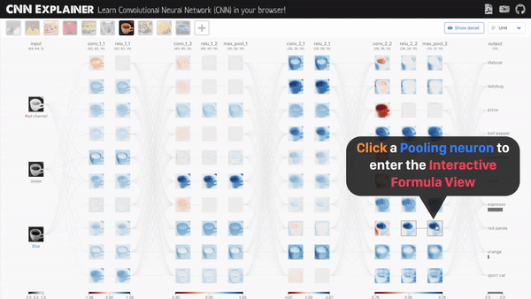
CNN 可视化：CNN Explainer 解释器
点击一个池化神经元，也可以看具体最大池化层是怎样工作的：
Notes:
Example filters learned by Krizhevsky et al. Each of the 96 filters shown here is of size [11x11x3], and each one is shared by the 55*55 neurons in one depth slice. Notice that the parameter sharing assumption is relatively reasonable: If detecting a horizontal edge is important at some location in the image, it should intuitively be useful at some other location as well due to the translationally-invariant structure of images. There is therefore no need to relearn to detect a horizontal edge at every one of the 55*55 distinct locations in the Conv layer output volume.

Slide 40
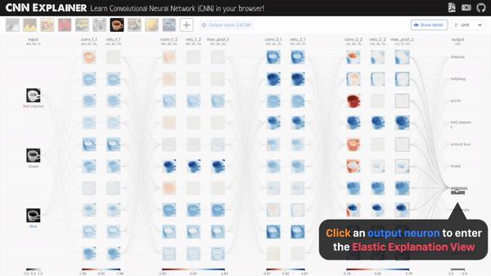
CNN 可视化：CNN Explainer 解释器
看清CNN是怎么输出预测的
点击最右侧的输出神经元，进入弹性解释视图：
Notes:
Example filters learned by Krizhevsky et al. Each of the 96 filters shown here is of size [11x11x3], and each one is shared by the 55*55 neurons in one depth slice. Notice that the parameter sharing assumption is relatively reasonable: If detecting a horizontal edge is important at some location in the image, it should intuitively be useful at some other location as well due to the translationally-invariant structure of images. There is therefore no need to relearn to detect a horizontal edge at every one of the 55*55 distinct locations in the Conv layer output volume.

Slide 41
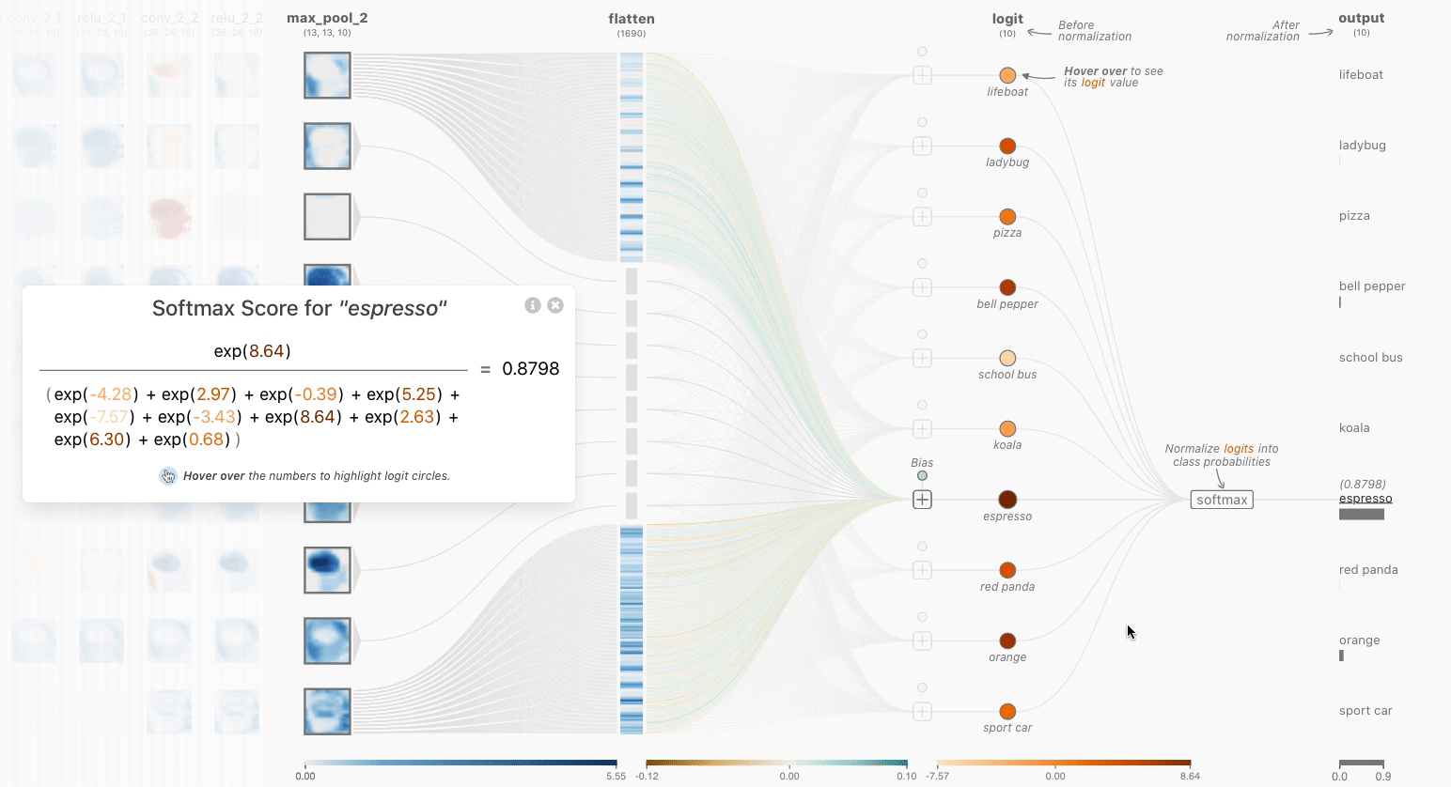
CNN 可视化：CNN Explainer 解释器
可以查看Softmax函数的详情
Notes:
Example filters learned by Krizhevsky et al. Each of the 96 filters shown here is of size [11x11x3], and each one is shared by the 55*55 neurons in one depth slice. Notice that the parameter sharing assumption is relatively reasonable: If detecting a horizontal edge is important at some location in the image, it should intuitively be useful at some other location as well due to the translationally-invariant structure of images. There is therefore no need to relearn to detect a horizontal edge at every one of the 55*55 distinct locations in the Conv layer output volume.

Slide 42

CNN 可视化：CNN Explainer 解释器
10层处理
Notes:
Example filters learned by Krizhevsky et al. Each of the 96 filters shown here is of size [11x11x3], and each one is shared by the 55*55 neurons in one depth slice. Notice that the parameter sharing assumption is relatively reasonable: If detecting a horizontal edge is important at some location in the image, it should intuitively be useful at some other location as well due to the translationally-invariant structure of images. There is therefore no need to relearn to detect a horizontal edge at every one of the 55*55 distinct locations in the Conv layer output volume.

Slide 43
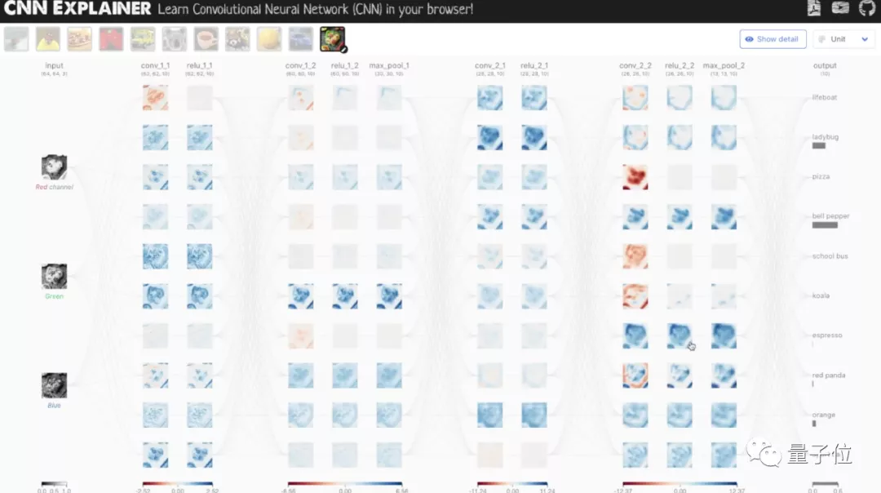
CNN 可视化：CNN Explainer 解释器
10层处理
Notes:
Example filters learned by Krizhevsky et al. Each of the 96 filters shown here is of size [11x11x3], and each one is shared by the 55*55 neurons in one depth slice. Notice that the parameter sharing assumption is relatively reasonable: If detecting a horizontal edge is important at some location in the image, it should intuitively be useful at some other location as well due to the translationally-invariant structure of images. There is therefore no need to relearn to detect a horizontal edge at every one of the 55*55 distinct locations in the Conv layer output volume.

Slide 44
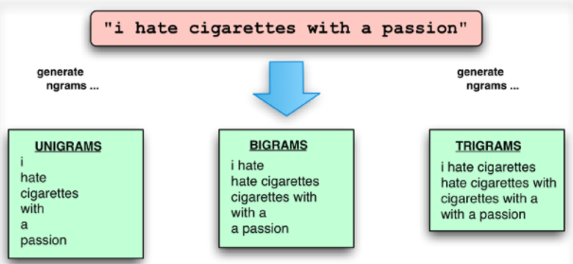
Ngram特征与卷积
如何用卷积操作来实现？

Slide 45
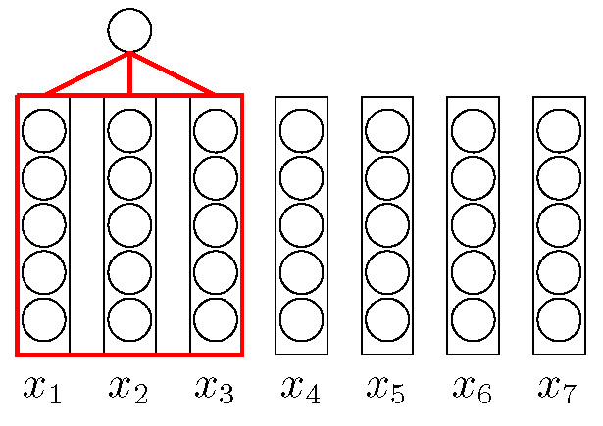
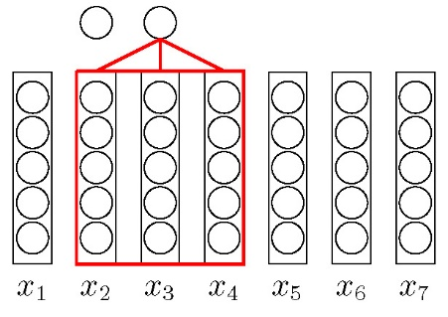
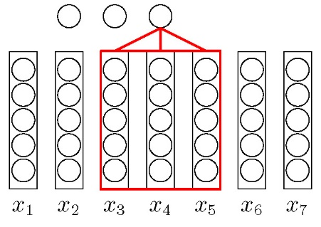
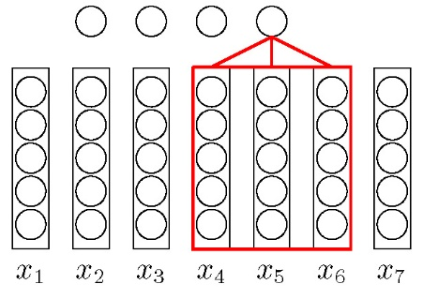
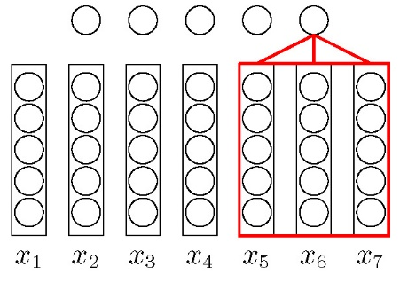
文本序列的卷积

Slide 46

基于卷积模型的句子表示
Y. Kim. “Convolutional neural networks for sentence classification”. In: arXiv preprint arXiv:1408.5882 (2014).

Slide 47


文本序列的卷积模型
输入
Filter
卷积层
Pooling层
输出

Slide 48
卷积的应用

Slide 49


AlphaGo
分布式系统：1202 个CPU 和176 块GPU
单机版：48 个CPU 和8 块GPU
走子速度：3 毫秒-2 微秒

Slide 50

目标检测（Object Detection）

Slide 51


Mask RCNN

Slide 52

OCR

Slide 53

图像生成

Slide 54


Deep Dream

Slide 55

风格迁移

Slide 56

对抗样本

Slide 57
https://nndl.github.io/

